Slide 1



INTRODUCTION
What is VBA
Future of VBA
VBA vs Macros

Slide 2

Started in 1993 with Excel
VBA runs within a host application rather than standalone
Future of VBA
VBA is still alive and kicking
Excel Online does NOT have any form of VBA
There is an alternative called TypeScript
TypeScript is the online version of VBA
https://docs.microsoft.com/en-us/office/dev/scripts/resources/vba-differences
NOT important for the next 4-5 years at least
Very, very few companies are working on this
https://www.thespreadsheetguru.com/blog/are-vba-macros-dead

Slide 3
VBA vs MACROS
VBA is the language
Macros is a general computing term which means performing steps
For our sake – they are interchangeable

Slide 4
No Ctrl + Z
VERY VERY VERY IMPORTANT
Macros cannot be undone using Ctrl + Z
Also,
After running a Macro, NO PREVIOUS ACTION can be undone
VERY ADVANCED, UNRELIABLE
Uses Class Modules
Should ONLY be done by an expert IT / VBA team
https://jkp-ads.com/Articles/UndoWithVBA00.asp

Slide 5
INTERFACE
Developer Tab
VBA Interface
Writing First Code
Run Macro

Slide 6
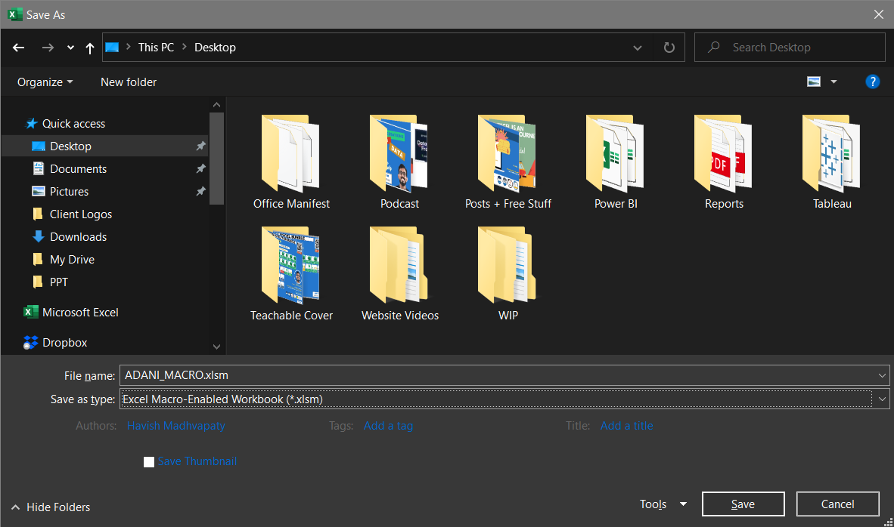
SAVE AS .XLSM

Slide 7
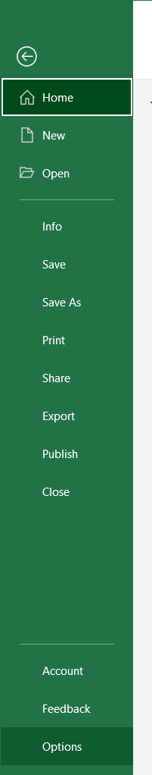
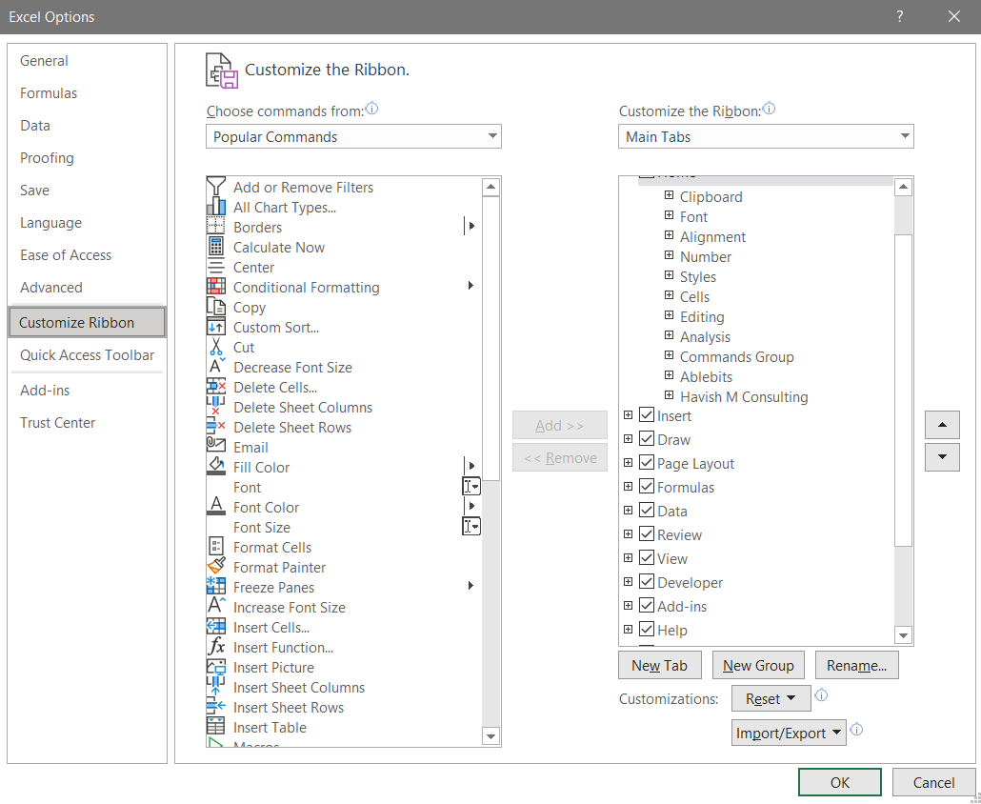
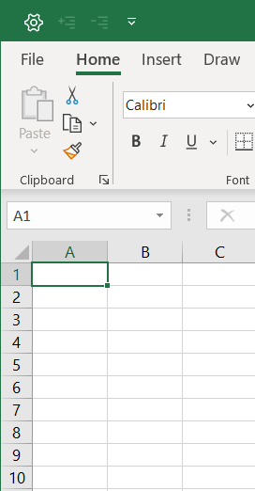
ENABLE DEVELOPER TAB
STEP 1
STEP 2
STEP 3

Slide 8
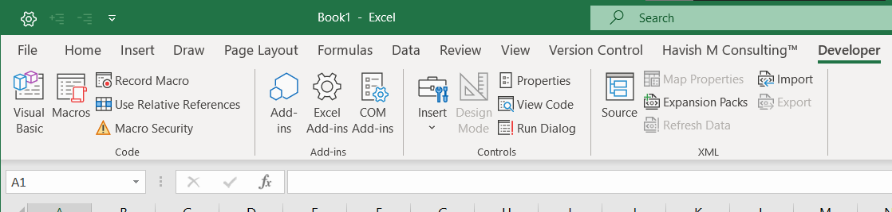
OPEN VISUAL BASIC (Alt + F11)

Slide 9
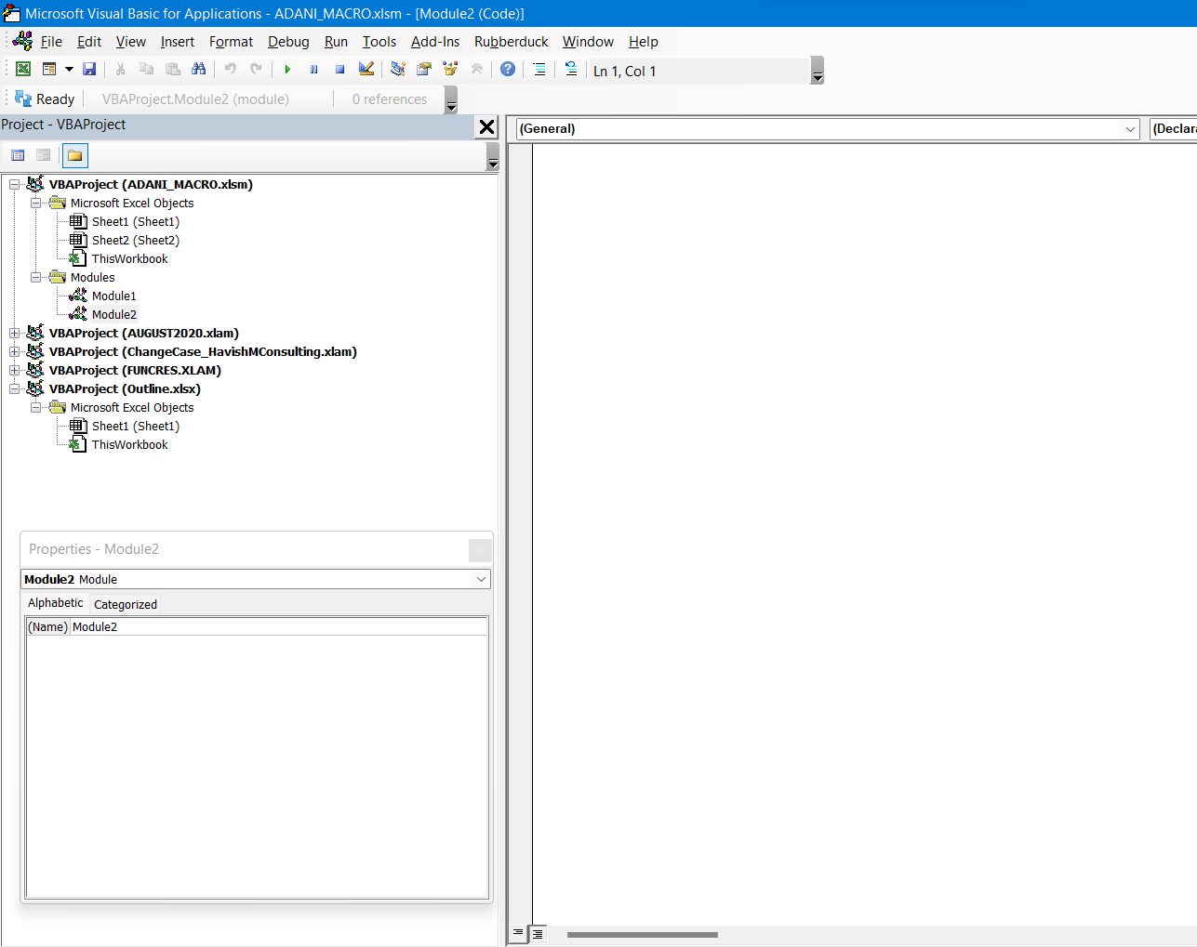
NOTE: ALL EXCEL FILES OPEN ON SYSTEM WILL SHOW HERE

Slide 10
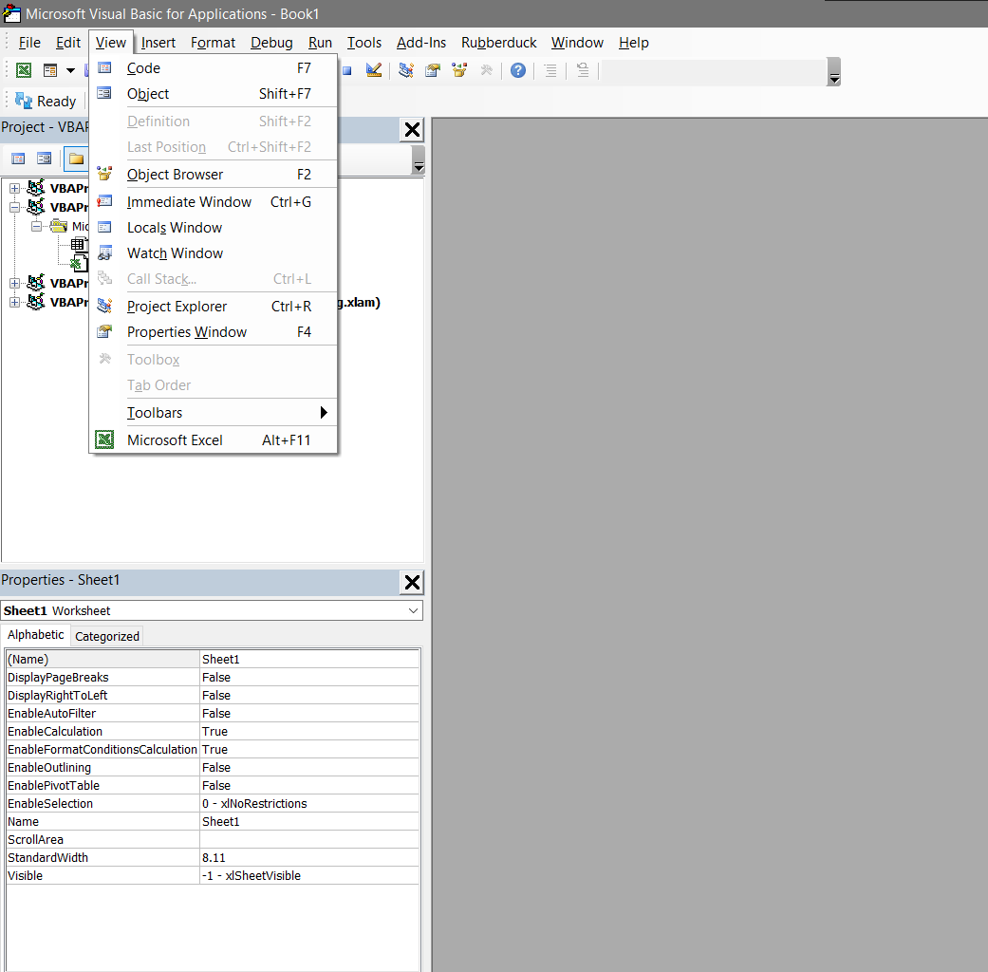
ENABLE PROJECT EXPLORER AND PROPERTIES WINDOW

Slide 11
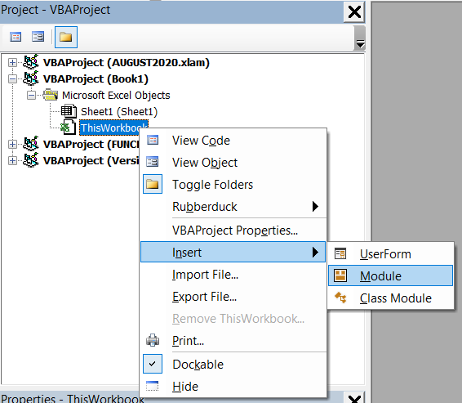
SELECT WORKBOOK > INSERT > MODULE
Modules are COMMON for the entire workbook
NOT sheet specific

Slide 12
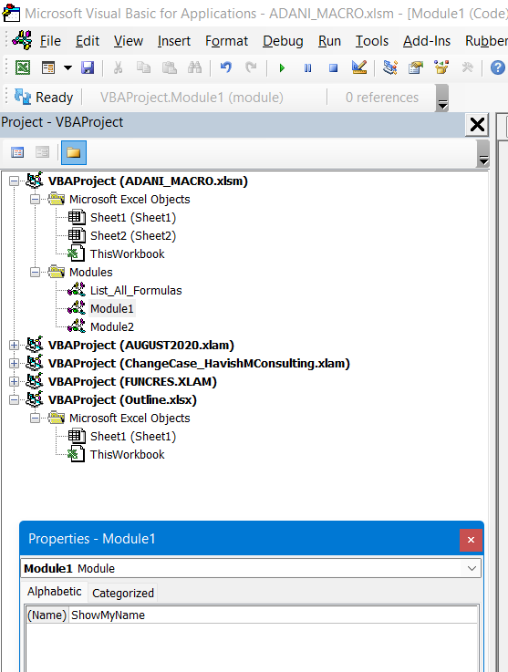
MODULE NAME CAN BE CHANGED – SPACES NOT ALLOWED
Multiple Modules allowed
Each Module can also have multiple codes

Slide 13
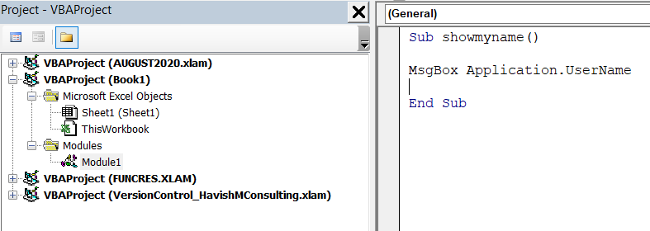
WRITE THE CODE

Slide 14
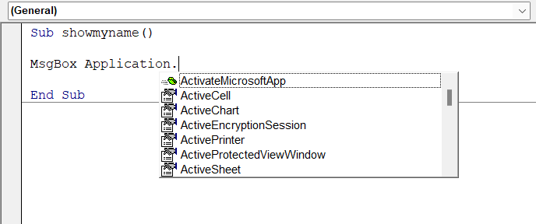
CODE SYNTAX
Code starts with Sub and ends with End Sub First Line of Code ends with ()
After a dot notation (.) options will appear

Slide 15
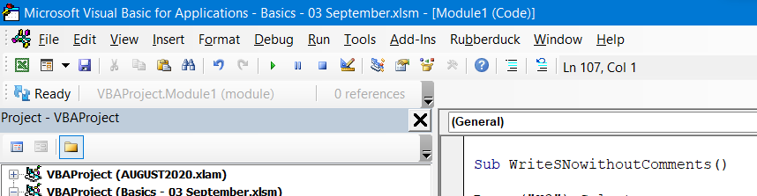
RUN MACROS FROM VBA WINDOW
Select code and Run (F5)
Use Reset whenever you get an error

Slide 16
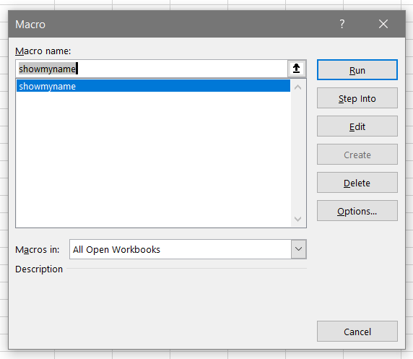
RUN MACROS WITH DEVELOPER > MACROS > RUN

Slide 17
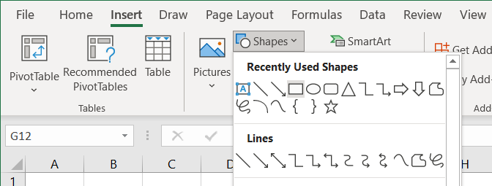
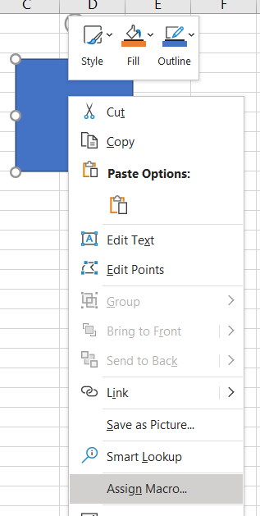
RUN MACRO FROM A SHAPE

Slide 18
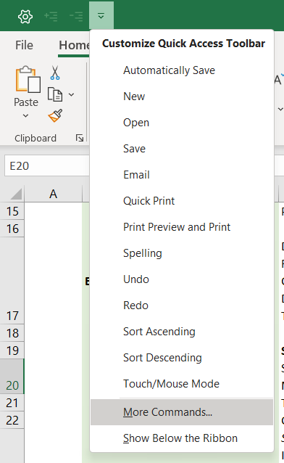
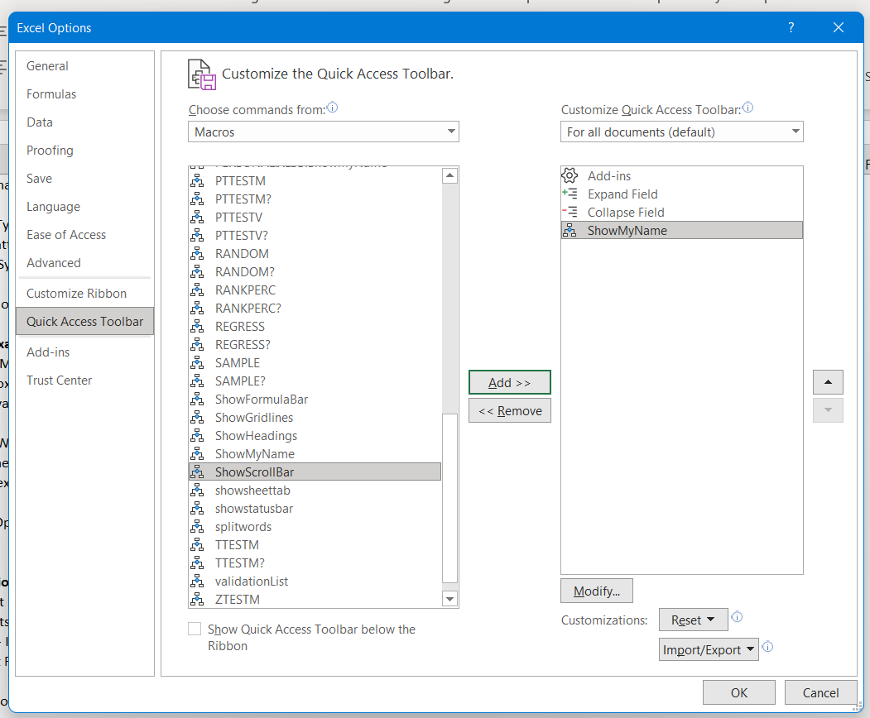
RUN MACRO FROM QAT

Slide 19
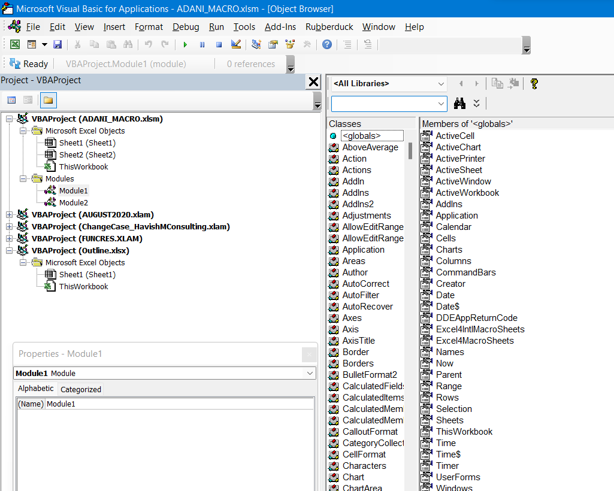
F2 - LIBRARIES

Slide 20
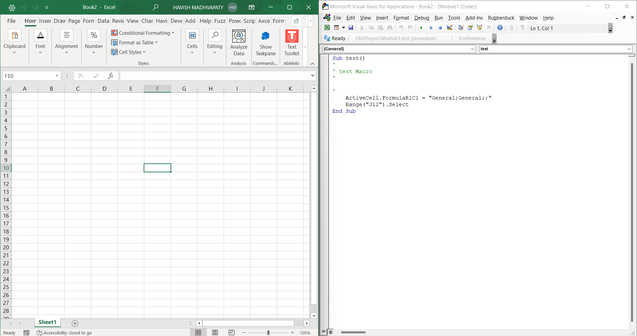
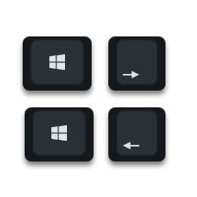
WORK ON VBA AND EXCEL AT SAME TIME (USE Windows + Left / Right)

Slide 21
COPYING CODES FROM INTERNET
List all Formulas
Table of Content

Slide 22
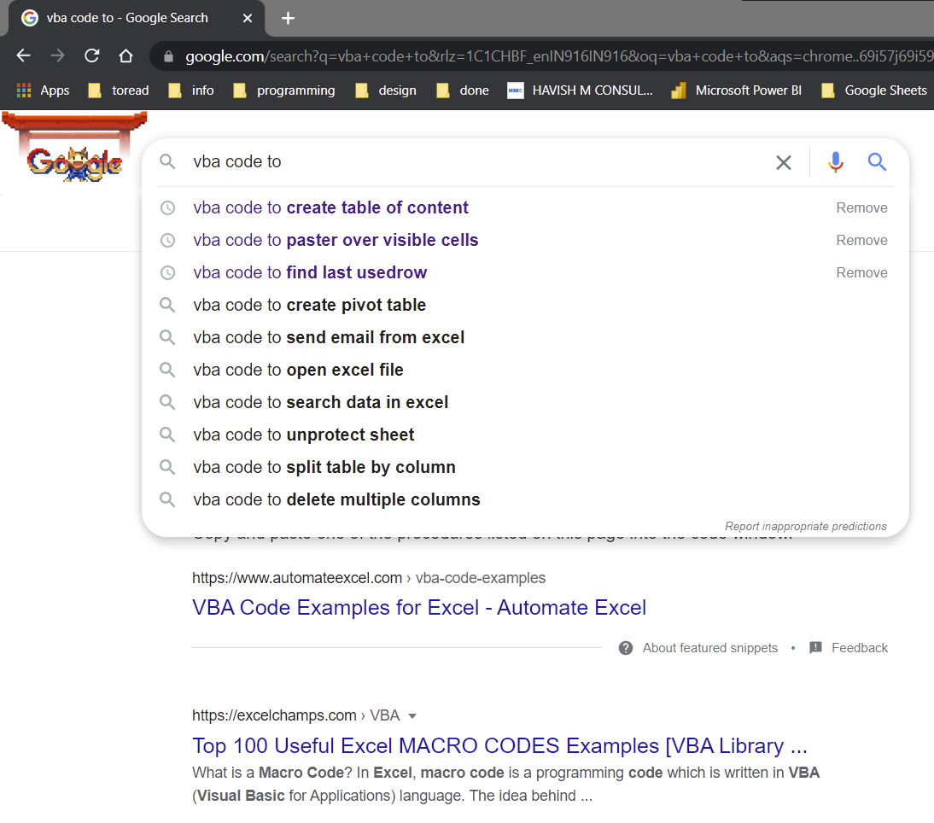
SEARCHING CODES ON INTERNET [VBA CODE TO …]

Slide 23
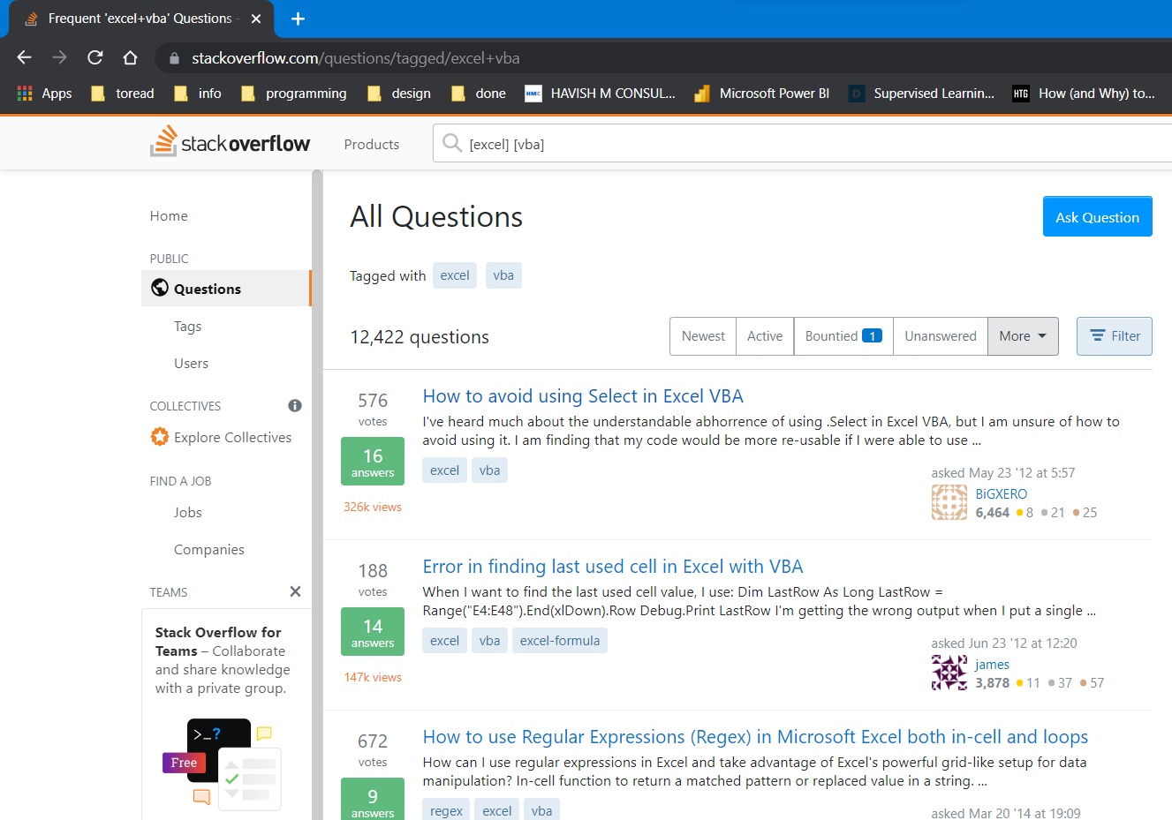
NOTES
Note: Almost all good websites have comments written – which explain how the code works and how to modify
There is no ONE perfect website for VBA codes – there are dozens of them
Finding the right solution and asking the right question is an art
Try asking question in different ways
Reading other questions + answers is a great way of learning
https://stackoverflow.com/questions/tagged/excel+vba

Slide 24
NOTES
Note: KILL is used to delete files
Be careful that your code does NOT use KILL unless you know exactly what it is supposed to do

Slide 25
EXAMPLES
LIST ALL FORMULAS
TABLE OF CONTENT

Slide 26
EXAMPLES
Never try to understand the complete code!
Waste of time
You cannot understand everything at the same time

Slide 27
RECORD MACROS
Absolute vs Relative

Slide 28
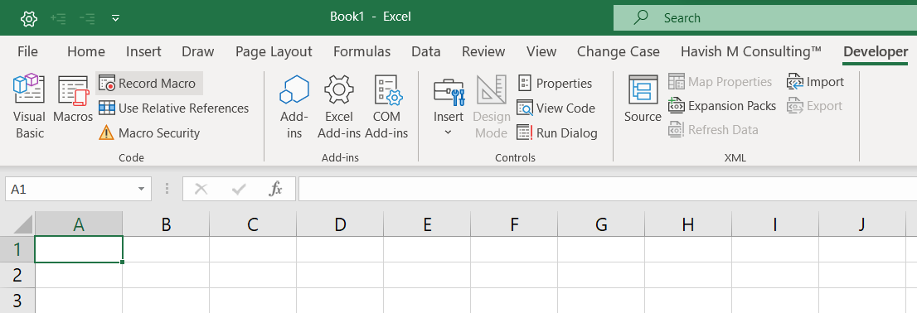
RECORD MACRO

Slide 29
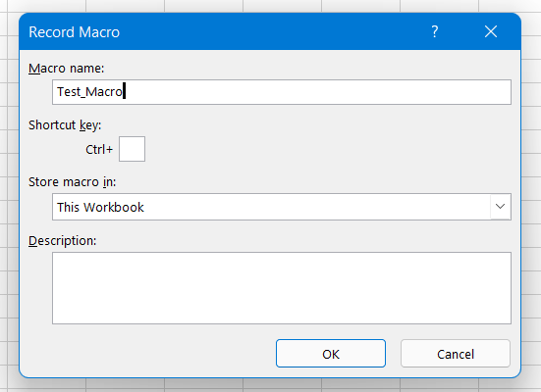
RECORD MACRO
Do not use shortcut
Personal Macro Workbook will allow you to access Macro in all workbooks
Description will simply add a comment

Slide 30
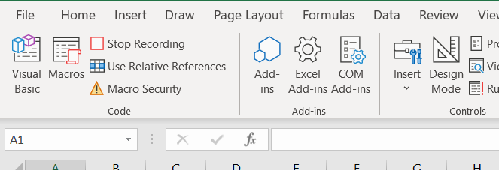
RECORD MACRO - STOP
It will create a new module

Slide 31
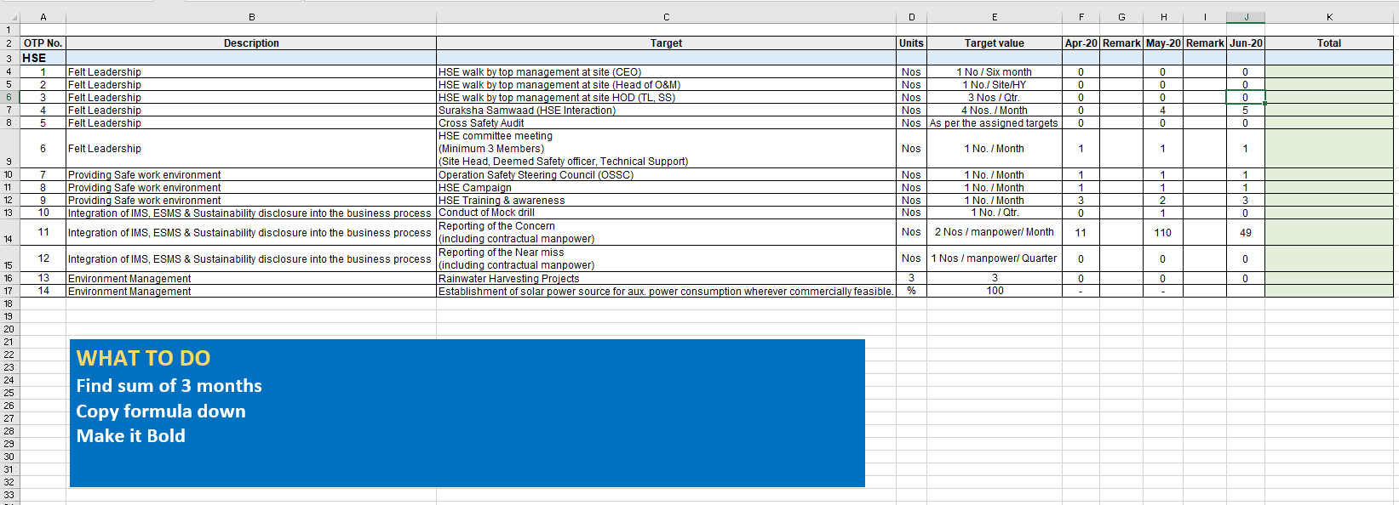
EXAMPLES
COPY FORMULA TILL LAST CELL

Slide 32
EXAMPLES
COPY FORMULA TILL LAST CELL
Sub Rec()
'Select K4
Range(“L4").Select
'Write formula - either of the two
ActiveCell.FormulaR1C1 = "=SUM(RC[-5]:RC[-1])"
ActiveCell.Formula = "=SUM(F4:J4)"
'Select Range
Range(“L4:L17").Select
'Copy Down (Ctrl + D)
Selection.FillDown
'Make Bold
Selection.Font.Bold = True
End Sub

Slide 33
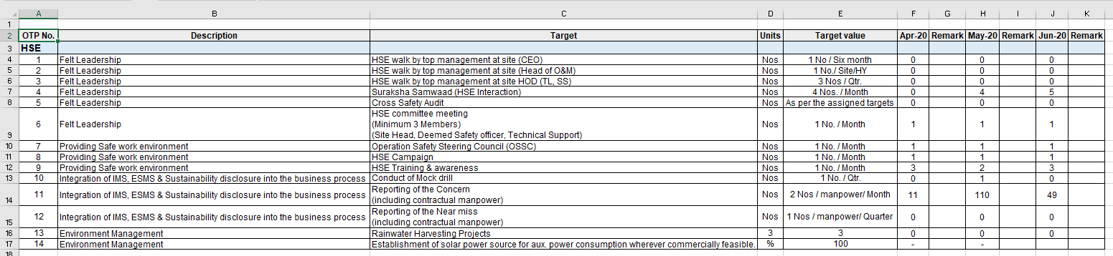
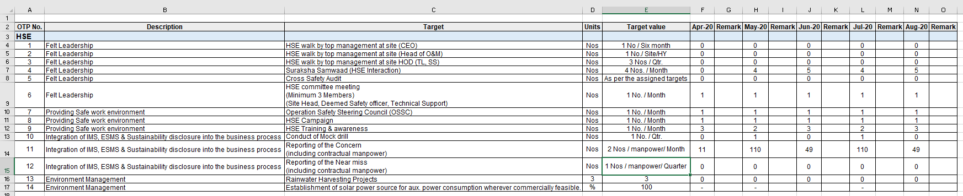
EXAMPLES
COPY FORMULA TILL LAST CELL DYNAMICALLY

Slide 34
EXAMPLES
COPY FORMULA TILL LAST CELL DYNAMICALLY
'Find lastcol with value
lastcolumn = Cells(2, Columns.Count).End(xlToLeft).Column
'Convert lastcol to letter
columnletter = Split(Cells(1, lastcolumn).Address(True, False), "$")(0)
'Find lastcol + one to write formula
lastcolumn = lastcolumn + 1
columnletterformula = Split(Cells(1, lastcolumn).Address(True, False), "$")(0)
'Select cell to write formula
Range(columnletterformula & "4").Select
'Select from Column F to lastcol
ActiveCell.Formula = "=SUM(F4:" & columnletter & "4)"
'Select from lastcol + 1 to Row 17
Range(columnletterformula & "4:" & columnletterformula & "17").Select
'Copy Formula Down
Selection.FillDown
https://www.thespreadsheetguru.com/blog/2014/7/7/5-different-ways-to-find-the-last-row-or-last-column-using-vba
https://wellsr.com/vba/2017/excel/vba-column-number-to-letter/

Slide 35
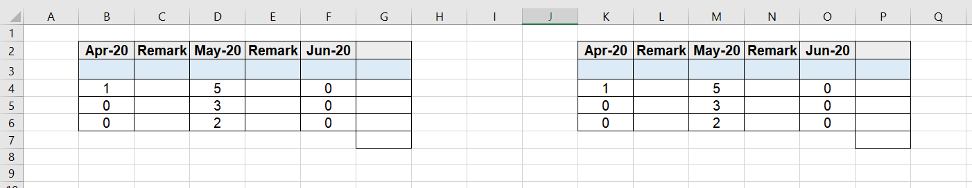
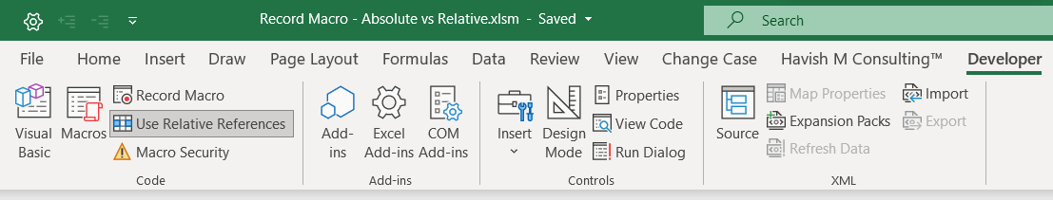
ABSOLUTE VS RELATIVE

Slide 36
ABSOLUTE VS RELATIVE
Sub Absolute()
Application.CutCopyMode = False
ActiveCell.FormulaR1C1 = "=SUM(RC[-5]:RC[-1])"
Range("G5").Select
Selection.FillDown
Range("G6").Select
Selection.FillDown
Range("G7").Select
Application.CutCopyMode = False
Selection.FormulaR1C1 = "=SUM(R[-3]C:R[-1]C)"
End Sub

Slide 37
ABSOLUTE VS RELATIVE
Sub Relative()
Application.CutCopyMode = False
ActiveCell.FormulaR1C1 = "=SUM(RC[-5]:RC[-1])"
ActiveCell.Range("A1:A3").Select
Selection.FillDown
ActiveCell.Offset(3, 0).Range("A1").Select
Application.CutCopyMode = False
ActiveCell.FormulaR1C1 = "=SUM(R[-3]C:R[-1]C)"
End Sub

Slide 38
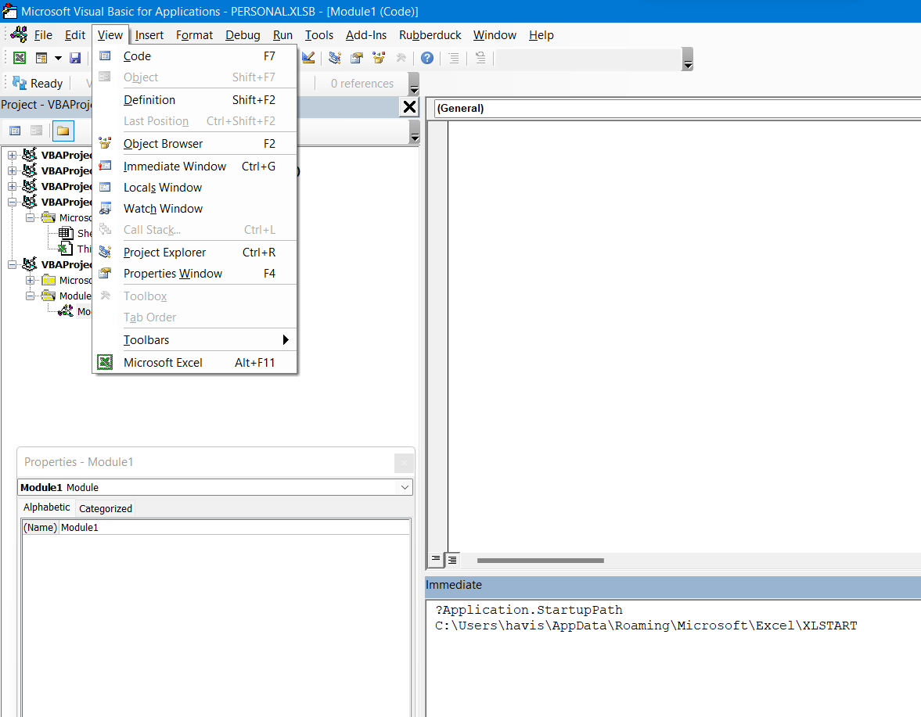
PERSONAL MACRO WORKBOOK
View > Immediate Window > ?Application.StartupPath

Slide 39
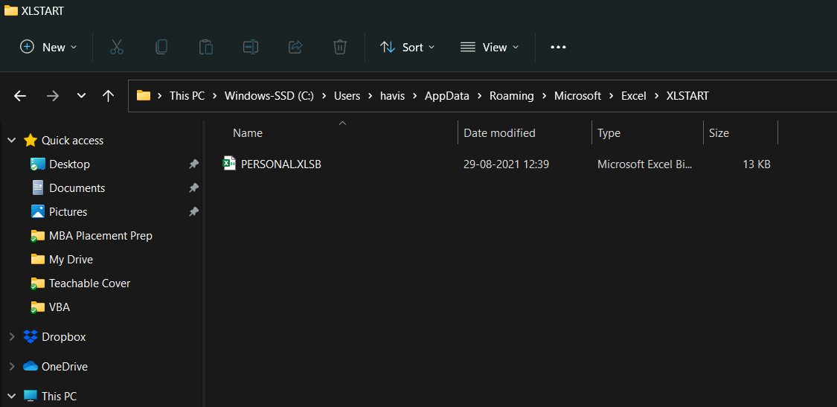
PERSONAL MACRO WORKBOOK
More details
https://www.rondebruin.nl/win/personal.htm
File can be seen here

Slide 40
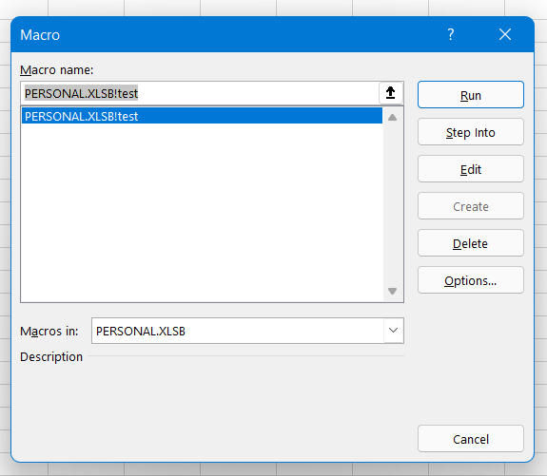
PERSONAL MACRO WORKBOOK
Will show on each workbook

Slide 41
RECORD MACROS
Excel vs TypeScript vs Google Sheets

Slide 42
Sub VBA_Macro()
'
' VBA_Macro Macro
'
'
ActiveCell.FormulaR1C1 = "Name"
Range("B1").Select
ActiveCell.FormulaR1C1 = "Sales"
Range("A2").Select
ActiveCell.FormulaR1C1 = "A"
Range("A3").Select
ActiveCell.FormulaR1C1 = "B"
Range("A4").Select
ActiveCell.FormulaR1C1 = "C"
Range("B2").Select
ActiveCell.FormulaR1C1 = "1"
Range("B3").Select
ActiveCell.FormulaR1C1 = "2"
Range("B4").Select
ActiveCell.FormulaR1C1 = "3"
Range("B5").Select
Selection.FormulaR1C1 = "=SUM(R[-3]C:R[-1]C)"
Selection.Font.Bold = True
With Selection.Interior
.Pattern = xlSolid
.PatternColorIndex = xlAutomatic
.ThemeColor = xlThemeColorAccent6
.TintAndShade = 0.799981688894314
.PatternTintAndShade = 0
End With
Range("A1:B1").Select
Range("B1").Activate
Selection.Font.Bold = True
Range("A1:B5").Select
Range("B5").Activate
With Selection
.HorizontalAlignment = xlCenter
.VerticalAlignment = xlBottom
.WrapText = False
.Orientation = 0
.AddIndent = False
.IndentLevel = 0
.ShrinkToFit = False
.ReadingOrder = xlContext
.MergeCells = False
End With
Range("B5").Select
End Sub
function main(workbook: ExcelScript.Workbook) {
let selectedSheet = workbook.getActiveWorksheet();
// Set range A1:B5 on selectedSheet
selectedSheet.getRange("A1:B5").setFormulasLocal([["Name","Sales"],["A","1"],["B","2"],["C","3"],[null,"=SUM(B2:B4)"]]);
// Set font bold to true for range B5 on selectedSheet
selectedSheet.getRange("B5").getFormat().getFont().setBold(true);
// Set horizontal alignment to ExcelScript.HorizontalAlignment.center for range A1:B5 on selectedSheet
selectedSheet.getRange("A1:B5").getFormat().setHorizontalAlignment(ExcelScript.HorizontalAlignment.center);
selectedSheet.getRange("A1:B5").getFormat().setIndentLevel(0);
// Set fill color to E2EFDA for range B5 on selectedSheet
selectedSheet.getRange("B5").getFormat().getFill().setColor("E2EFDA");
}
/** @OnlyCurrentDoc */
function Test() {
var spreadsheet = SpreadsheetApp.getActive();
spreadsheet.getRange('A1').activate();
spreadsheet.getCurrentCell().setValue('Name');
spreadsheet.getRange('B1').activate();
spreadsheet.getCurrentCell().setValue('Sales');
spreadsheet.getRange('A2').activate();
spreadsheet.getCurrentCell().setValue('A');
spreadsheet.getRange('A3').activate();
spreadsheet.getCurrentCell().setValue('B');
spreadsheet.getRange('A4').activate();
spreadsheet.getCurrentCell().setValue('C');
spreadsheet.getRange('B2').activate();
spreadsheet.getCurrentCell().setValue('1');
spreadsheet.getRange('B3').activate();
spreadsheet.getCurrentCell().setValue('2');
spreadsheet.getRange('B4').activate();
spreadsheet.getCurrentCell().setValue('3');
spreadsheet.getRange('B5').activate();
spreadsheet.getCurrentCell().setFormula('=SUM(B2:B4)');
spreadsheet.getActiveRangeList().setFontWeight('bold');
spreadsheet.getRange('A1').activate();
var currentCell = spreadsheet.getCurrentCell();
spreadsheet.getSelection().getNextDataRange(SpreadsheetApp.Direction.NEXT).activate();
currentCell.activateAsCurrentCell();
currentCell = spreadsheet.getCurrentCell();
spreadsheet.getSelection().getNextDataRange(SpreadsheetApp.Direction.DOWN).activate();
currentCell.activateAsCurrentCell();
spreadsheet.getRange('A1:B5').activate();
spreadsheet.getActiveRangeList().setHorizontalAlignment('center');
spreadsheet.getRange('B5').activate();
spreadsheet.getActiveRangeList().setBackground('#d9ead3');
};

Slide 43
PROGRAMMING BASICS
Data Types
Formatter
Code Syntax
Types of Procedures
MsgBox and InputBox
IF THEN
Functions UDF

Slide 44
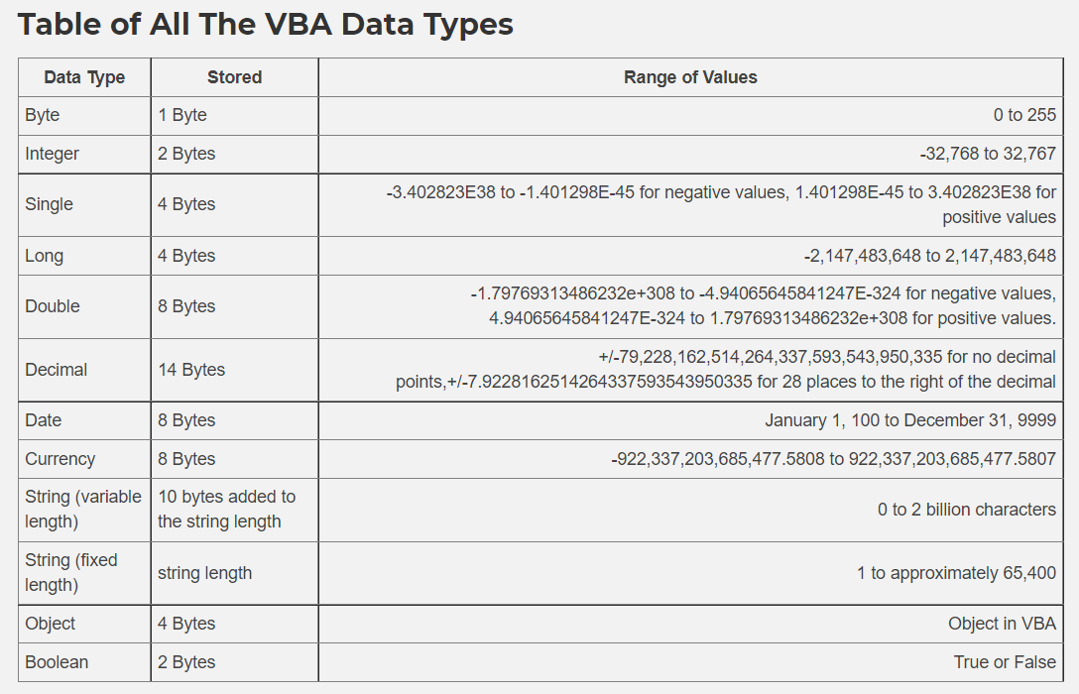
DATA TYPES

Slide 45
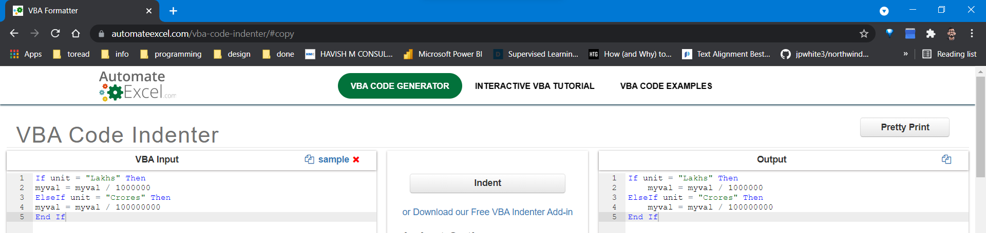
FORMATTER

Slide 46
CODE SYNTAX
Code starts with Sub and ends with End Sub First Line of Code ends with ()
After a dot notation (.) options will appear

Slide 47
DIM – Variable Declaration
Description | Format | Example
Basic variable | Dim [variable name] As [Type] | Dim count As Long Dim amount As Currency Dim name As String Dim visible As Boolean
Fixed String | Dim [variable name] As String * [size] | Dim s As String * 4 Dim t As String * 10
Variant | Dim [variable name] As Variant Dim [variable name] | Dim var As Variant Dim var
Object using Dim and New | Dim [variable name] As New [object type] | Dim coll As New Collection Dim coll As New Class1
Object using Dim, Set and New | Dim [variable name] As [object type] Set [variable name] = New [object type] | Dim coll As Collection Set coll = New Collection Dim coll As Class1 Set coll = New Class1
Static array | Dim [variable name]([first] To [last] ) As [Type] | Dim arr(1 To 6) As Long
Dynamic array | Dim [variable name]() As [Type] ReDim [variable name]([first] To [last]) | Dim arr() As Long ReDim arr(1 To 6)
External Library (Early Binding)* | Dim [variable name] As New [item] | Dim dict As New Dictionary
External Library (Early Binding using Set)* | Dim [variable name] As [item] Set [variable name] = New [item] | Dim dict As Dictionary Set dict = New Dictonary
External Library (Late Binding) | Dim [variable name] As Object Set [variable name] = CreateObject("[library]") | Dim dict As Object Set dict = CreateObject("Scripting.Dictionary")
Dimension
Variable Declaration
Option Explicit
Best practice – makes it mandatory to declare variables
VBA Dim - A Complete Guide - Excel Macro Mastery

Slide 48
TYPES OF PROCEDURES
There are two types of procedures:
First:
Sub (Subroutine) 99.99%
Second:
Function 0.01% -
much more rare and advanced

Slide 49
SUBROUTINE
Sub ShowMyName()
MsgBox ("Hi"), vbOKCancel + vbDefaultButton2
End Sub
Spaces are not allowed - cannot start with a number

Slide 50
BREAK INTO 2 LINES
Sub ShowMyName()
MsgBox ("Hi"), vbOKCancel _
+ vbDefaultButton2
End Sub
Use [space] [underscore]

Slide 51
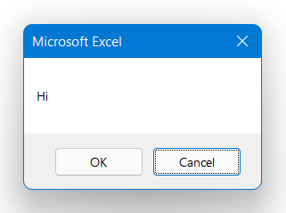
MESSAGEBOX TYPES
Sub ShowMyName()
MsgBox ("Hi"), vbOKCancel + vbDefaultButton2
End Sub

Slide 52
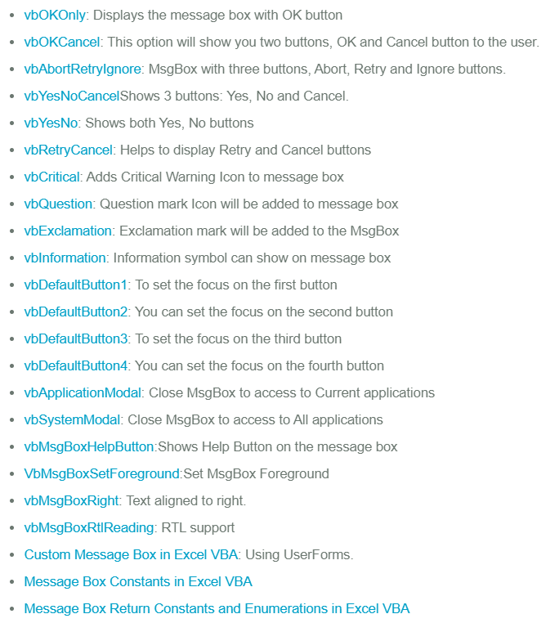
MESSAGEBOX TYPES
https://analysistabs.com/vba/msgbox/

Slide 53
TAKE VALUE AND PUSH VALUE
Sub WriteValuetoCell()
Range("D3").Value = "Hello!"
OR
cells(3, 4).Value = "Hello!"
End Sub
Sub PicktheValuefromCell()
MsgBox Range("F3").Value
End Sub
Sub PicktheValuefromDiffSheet()
'Write name of the sheet before selecting the cell
MsgBox Worksheets("Second Sheet").Range("B2").Value
End Sub

Slide 54
CALL FROM ANOTHER
Sub MiniFunction01()
MsgBox "Hello"
End Sub
Sub MiniFunction02()
MsgBox "World"
End Sub
Sub CallFunctions()
Call MiniFunction01
Call MiniFunction02
End Sub

Slide 55
SERIAL NUMBER
Sub WriteSNowithoutComments()
Range("H3").Select
lastval = InputBox("What is the last number?")
If lastval = vbNullString Then
MsgBox ("No value selected!")
Exit Sub
Else
If IsNumeric(lastval) = True Then
For i = 1 To lastval
Range("H" & i + 2).Value = i
Next i
Else
MsgBox ("Please enter a number")
End If
End If
End Sub
Learning:
IsNumeric
For Next
If End If

Slide 56
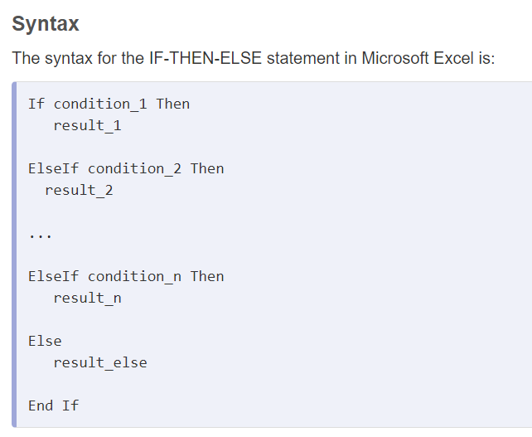
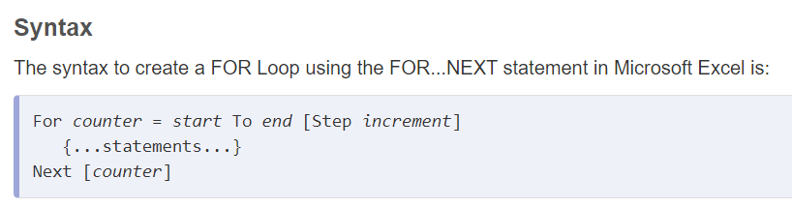
IF ENDIF AND FOR NEXT

Slide 57
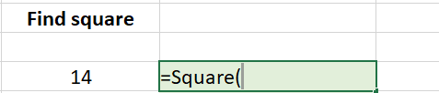
USER DEFINED FUNCTION (UDF)
'Function with single input
Function Square(myinput As Long)
Square = myinput ^ 2
End Function
NOTE:
Functions do not have Tooltips
'Function with 2 inputs
Function MyGST(myval As Single, gst_amt As Single)
MyGST = myval + (myval * (gst_amt / 100))
End Function
Function UoM(myval As Double, unit As String)
If unit = "Lakhs" Then
UoM = myval / 100000
Else
UoM = myval / 10000000
End If
End Function
https://stackoverflow.com/questions/14731675/is-there-a-way-to-make-udf-that-gives-a-description-like-the-native-excel-functi

Slide 58
FUNCTION
'In VBA we CANNOT use Excel functions
'To use an Excel function in VBA, we use Application.WorksheetFunction
Function CountErrors(cells As Range) As Long
Dim cell As Range
For Each cell In cells
If Application.WorksheetFunction.IsError(cell) = True Then
CountErrors = CountErrors + 1
End If
Next
End Function

Slide 59
UDF WITHIN UDF
'Use UDF inside UDF
'https://stackoverflow.com/questions/20241659/using-an-excel-udf-inside-another-udf
'IMPORTANT: data type should be SAME in both UDF
Function Test(myval As Long)
Test = Square(myval) + 2
End Function

Slide 60
USERFORMS

Slide 61
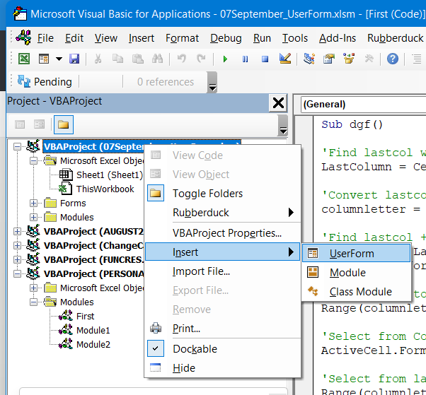
CREATE USERFORM

Slide 62
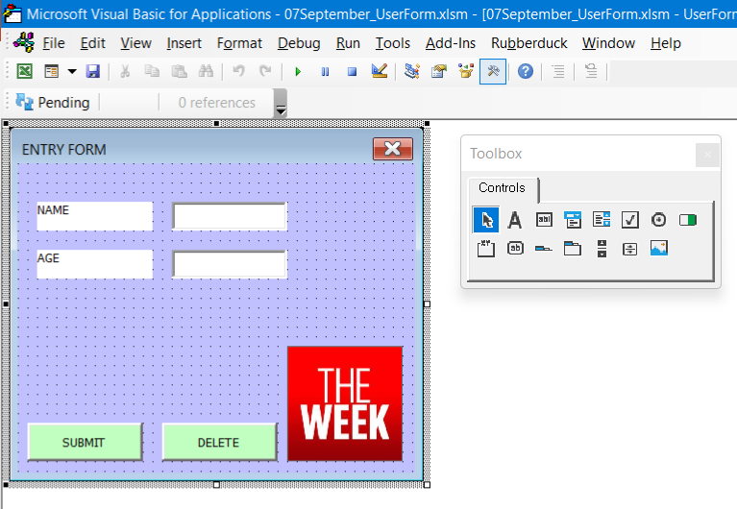
TOOLBOX

Slide 63
TOOLBOX
Double click SUBMIT button to open the code

Slide 64
TOOLBOX
Private Sub CommandButton1_Click()
'Unprotect
Dim Ws As Worksheet
Set Ws = Worksheets("Sheet1")
Ws.Unprotect Password:="pass"
'find the last row
LastRow = Cells(Rows.Count, "A").End(xlUp).Row
'put values in cells
Range("A" & LastRow + 1).Value = txt_name.Value
Range("B" & LastRow + 1).Value = txt_Age.Value
'remove old values
txt_name.Value = ""
txt_Age.Value = ""
'Set focus on the Name
txt_name.SetFocus
'Protect again
Set Ws = Worksheets("Sheet1")
Ws.Protect Password:="pass"
End Sub
Note:
Module is required to open the UserForm
Sub ShowForm()
UserForm1.Show
End Sub

Slide 65
DEBUGGING AND IMMEDIATE WINDOW

Slide 66
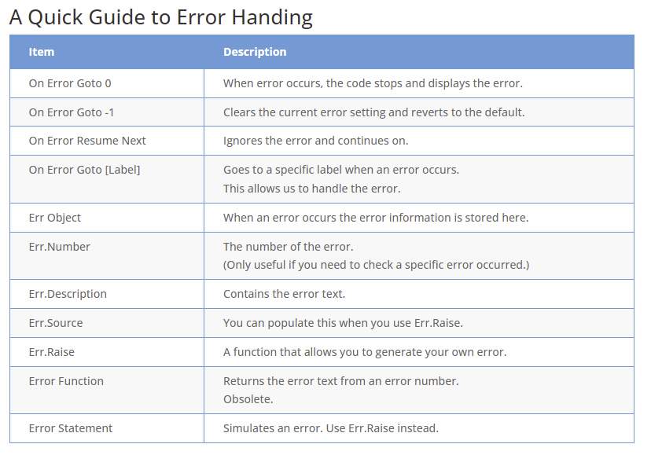
ERRORS
https://excelmacromastery.com/vba-error-handling/
There are three types of errors in VBA:
Syntax
Compilation
Runtime

Slide 67
INTRODUCTION TO ARRAYS

Slide 68
ARRAYS
https://excelmacromastery.com/excel-vba-array/

Slide 69
INTRODUCTION TO REGEX

Slide 70
REGEX
https://analystcave.com/excel-regex-tutorial/

Slide 71
CREATE ADD-IN

